Slide 1
ACCIDENT RECORD MANAGEMENT SYSTEM
LRG Govt Arts college for women
A. Jerlin jemela III B. Sc computer science shift 1
Guide: suganthi

Slide 2
ABSTRACT
The Accident Record Management System (ARMS) was produced utilizing Adobe Dreamweaver as the Integrated Development Environments JAVA were utilized for the frontend, was utilized as the scripting dialect, and SQL filled in as the database server. Most of the languages and tools utilized were open source which guaranteed that the application would be robust, reusable, cheap and highly scalable. The result of the developed system demonstrates that road safety officers, clients, policy producers and every other stakeholder can have the capacity to register, login, submit reports and run questions on data that has been already gone into the system, for example, the accident that happened on a particular route or the accident in which a recognized casualty was included. Policy creators can run these inquiries keeping in mind the end goal to make appropriate steps in minimizing road traffic accident occurrences. In conclusion, this system will help make a paperless other option to the present strategy for ARMS data and consequently make data dissemination faster and furthermore enhance first aid to accident occurrences.

Slide 3
OBJECTIVE
The main objective of this system is to provide convenience to the management team bydeveloping a digital system to make processes regarding Traffic Management easier.These all the records are stored in the database when the inspector register the details via this application.

Slide 4
HARDWARE SPECFICATION
Processor : P 4 700 GHz.
RAM : 4 GB RAM
Hard Disk Drive : 180 GB

Slide 5
SOFTWARE SPECIFICATION
Operating System : Windows 7/8/10
Front End : JAVA
Back End : SQL

Slide 6
EXISTING SYSTEM
This system is very hard to find accident which may cause some issues. It can’t be searching the accident list if we want to search the particular criminal very difficult to tracking. accident details are stored as document wise so we can’t search the criminals.
DISADVANTAGES
The existing system has the following drawbacks.
There is not possible to find one particular accident detail.
Lot of paper to be wasted
It takes too much time to register the accident details

Slide 7
PROPOSED SYSTEM
In this accident monitoring system easily find the person has any case or not. Using an area id based we can find the accident details which could be easy to find the criminal details. Any time anywhere we can see about the accident detail, we no need to take the file anywhere.
ADVANTAGES
Easy to find accident details
Fully systematic process
No one will be escaped

Slide 8
Modules
Admin Login
Here admin is an only one login to follow this software, if there’s an lot of admin’s are there they can also normally use it. Admin the main role is an do after the login.
Accident details entry
If anywhere the accident has been happened the admin collect all the information and store this module. These values are stored into the database table. Once the details have been captured it will automatically close.

Slide 9
Case Registration
This module will be handling the process of register the case to the respective members. If once case has been scheduled police department will take care for the investigation.
City wise & district wise count
We can search and count details as date wise, city and district wise which given cumulative frequency result, which may avoid the solution for the frequent accident.
Accident history
We can track the accident history by the accident id, collect the all the information about the accident and display in front of the screen,

Slide 10

Data Flow Diagram
Level 0

Slide 11
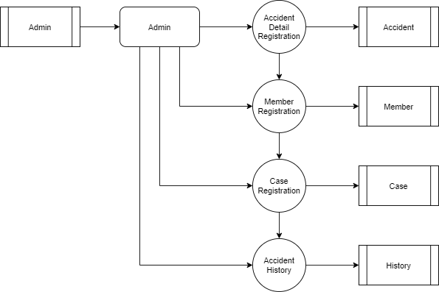
Level 1:

Slide 12
TABLE NAME: ADMIN

Slide 17
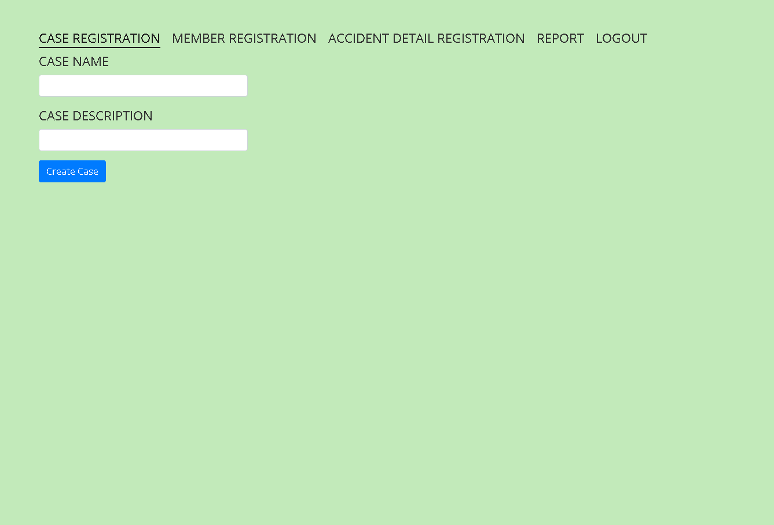

Slide 18
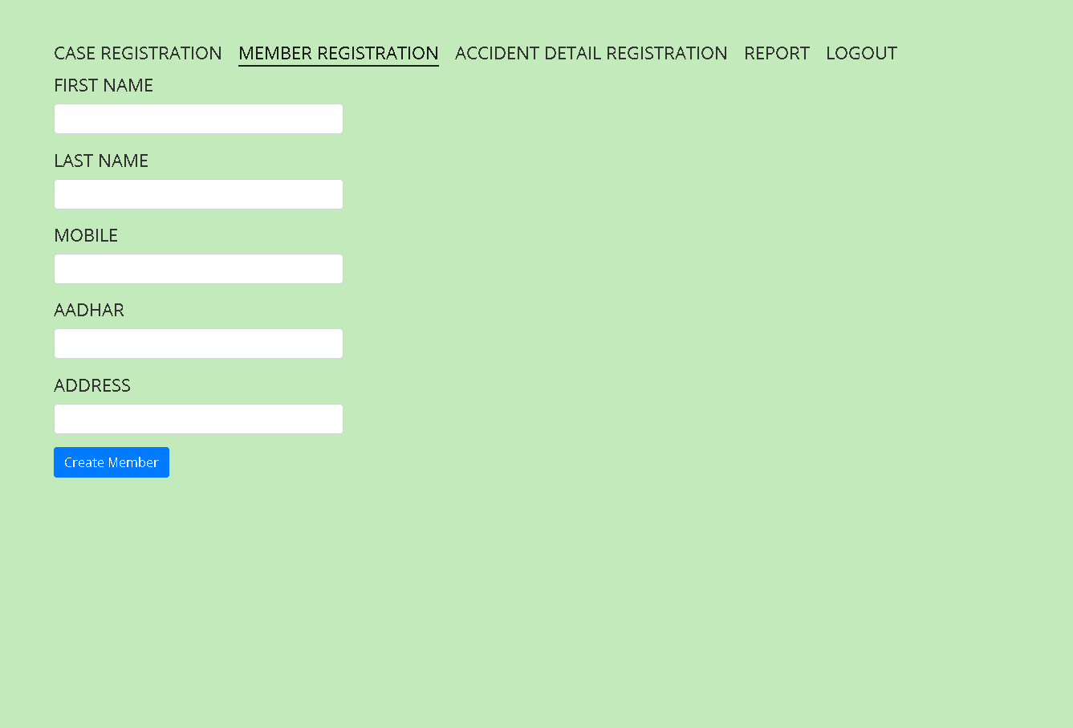

Slide 19
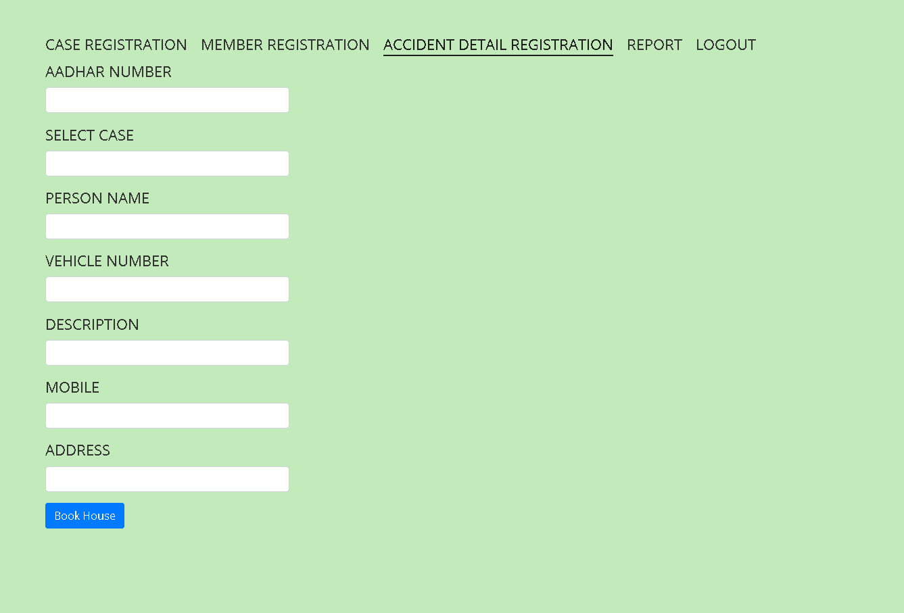

Slide 20
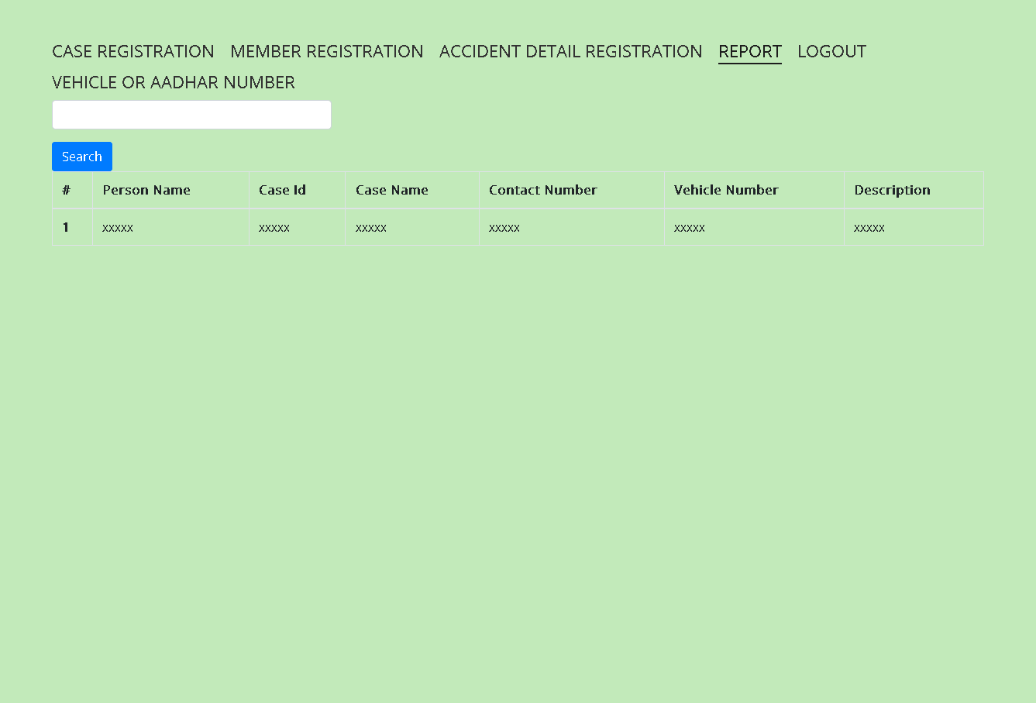

Slide 21
Thank You

